Slide 1








Text
Wish it was this easy to see your employees' cyber risk score?
Well, now it is...
Notes:
Edit fonts, colours, language and add your logo
Download when finished by going to: File >> Save/Download (either .jpeg or .png format)
Share your ad across social media and link to your relevant landing page

Slide 2

THE DARK WEB
IS A SCARY PLACE
We can help keep you out of it.
Book your free dark web scan today.
Notes:
Edit fonts, colours, language and add your logo
Download when finished by going to: File >> Save/Download (either .jpeg or .png format)
Share your ad across social media and link to your relevant landing page

Slide 3


Your employees aren't the weakest link...
...they're your strongest defence against cyber crime.
Notes:
Edit fonts, colours, language and add your logo
Download when finished by going to: File >> Save/Download (either .jpeg or .png format)
Share your ad across social media and link to your relevant landing page

Slide 4

Don't let your users become sitting ducks for cyber criminals...
Chat with us today

Slide 5

Drive secure user behaviour with bite-sized training modules.
Chat with us today
Notes:
Edit fonts, colours, language and add your logo
Download when finished by going to: File >> Save/Download (either .jpeg or .png format)
Share your ad across social media and link to your relevant landing page

Slide 6

Employees often share sensitive info on social media
Learn how to reduce user risk with regular training
Notes:
Edit fonts, colours, language and add your logo
Download when finished by going to: File >> Save/Download (either .jpeg or .png format)
Share your ad across social media and link to your relevant landing page

Slide 7

Can your employees spot a phish?
Let's find out...
Notes:
Edit fonts, colours, language and add your logo
Download when finished by going to: File >> Save/Download (either .jpeg or .png format)
Share your ad across social media and link to your relevant landing page

Slide 8
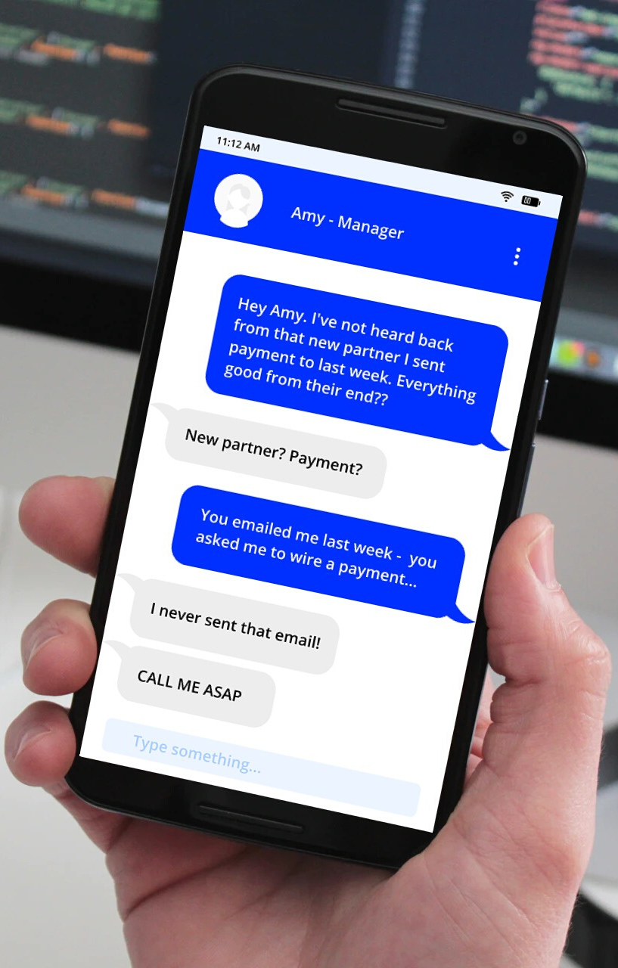
Did your CEO really request that wire transfer?
Train your employees to spot Business Email Compromise (BEC) scams
Notes:
Edit fonts, colours, language and add your logo
Download when finished by going to: File >> Save/Download (either .jpeg or .png format)
Share your ad across social media and link to your relevant landing page

Slide 9

Eliminate your policy pains
with automation.
Chat with us today
Notes:
Edit fonts, colours, language and add your logo
Download when finished by going to: File >> Save/Download (either .jpeg or .png format)
Share your ad across social media and link to your relevant landing page

Slide 10


SOCIAL MEDIA
PHISHING
IS ON THE RISE
Notes:
Edit fonts, colours, language and add your logo
Download when finished by going to: File >> Save/Download (either .jpeg or .png format)
Share your ad across social media and link to your relevant landing page

Slide 11



Staff still writing passwords on
post-it notes?
My email
password:
P@SSw0Rd1!
Let's talk...
Notes:
Edit fonts, colours, language and add your logo
Download when finished by going to: File >> Save/Download (either .jpeg or .png format)
Share your ad across social media and link to your relevant landing page

Slide 12
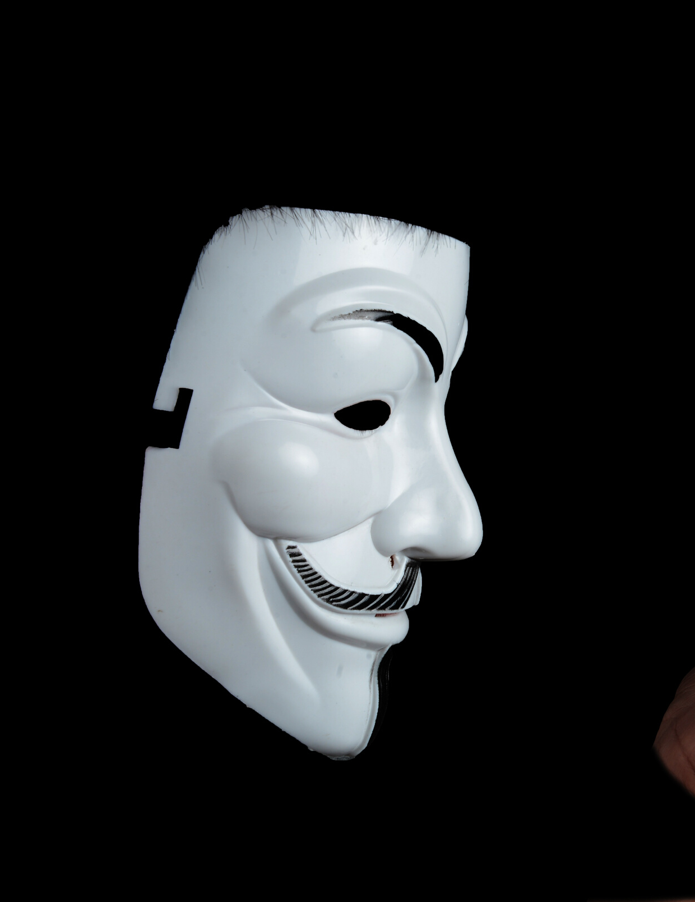


Business Email Compromise (BEC):
- is when an attacker hacks into a corporate email account and impersonates the real owner to defraud the
company.
Notes:
Edit fonts, colours, language and add your logo
Download when finished by going to: File >> Save/Download (either .jpeg or .png format)
Share your ad across social media and link to your relevant landing page

Slide 13
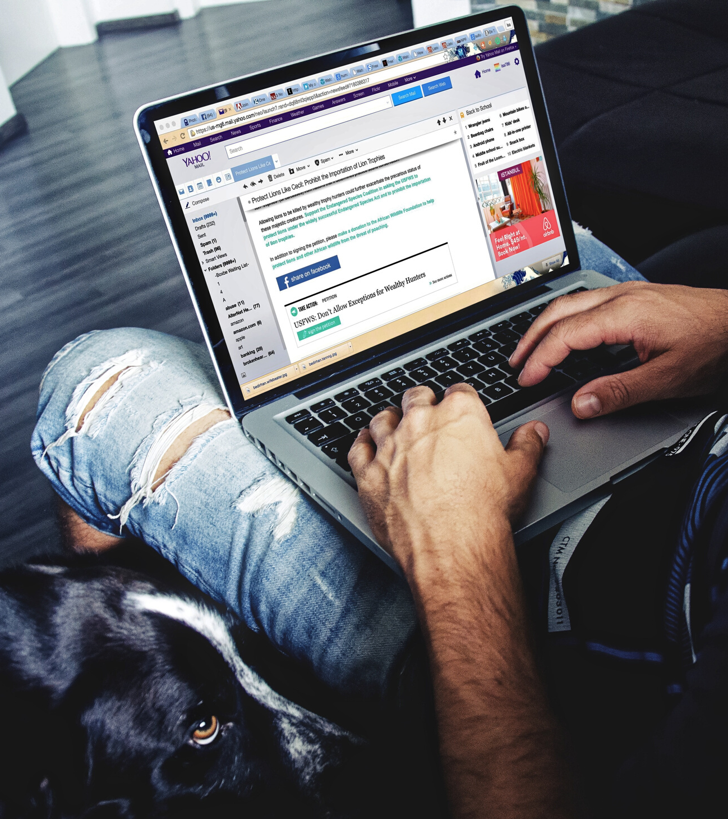

Spear-Phishing:
- a highly targeted form
of phishing, involving bespoke emails sent to well-researched victims.
Notes:
Edit fonts, colours, language and add your logo
Download when finished by going to: File >> Save/Download (either .jpeg or .png format)
Share your ad across social media and link to your relevant landing page

Slide 14


Social Engineering:
- an attack vector that relies on manipulating users in order to gain access to money, systems or personal information.
Notes:
Edit fonts, colours, language and add your logo
Download when finished by going to: File >> Save/Download (either .jpeg or .png format)
Share your ad across social media and link to your relevant landing page

Slide 15

Vishing Attack:
- a form of voice phishing, where fraudulent phone calls are used to trick people into
giving money or personal information.
Notes:
Edit fonts, colours, language and add your logo
Download when finished by going to: File >> Save/Download (either .jpeg or .png format)
Share your ad across social media and link to your relevant landing page

Slide 16
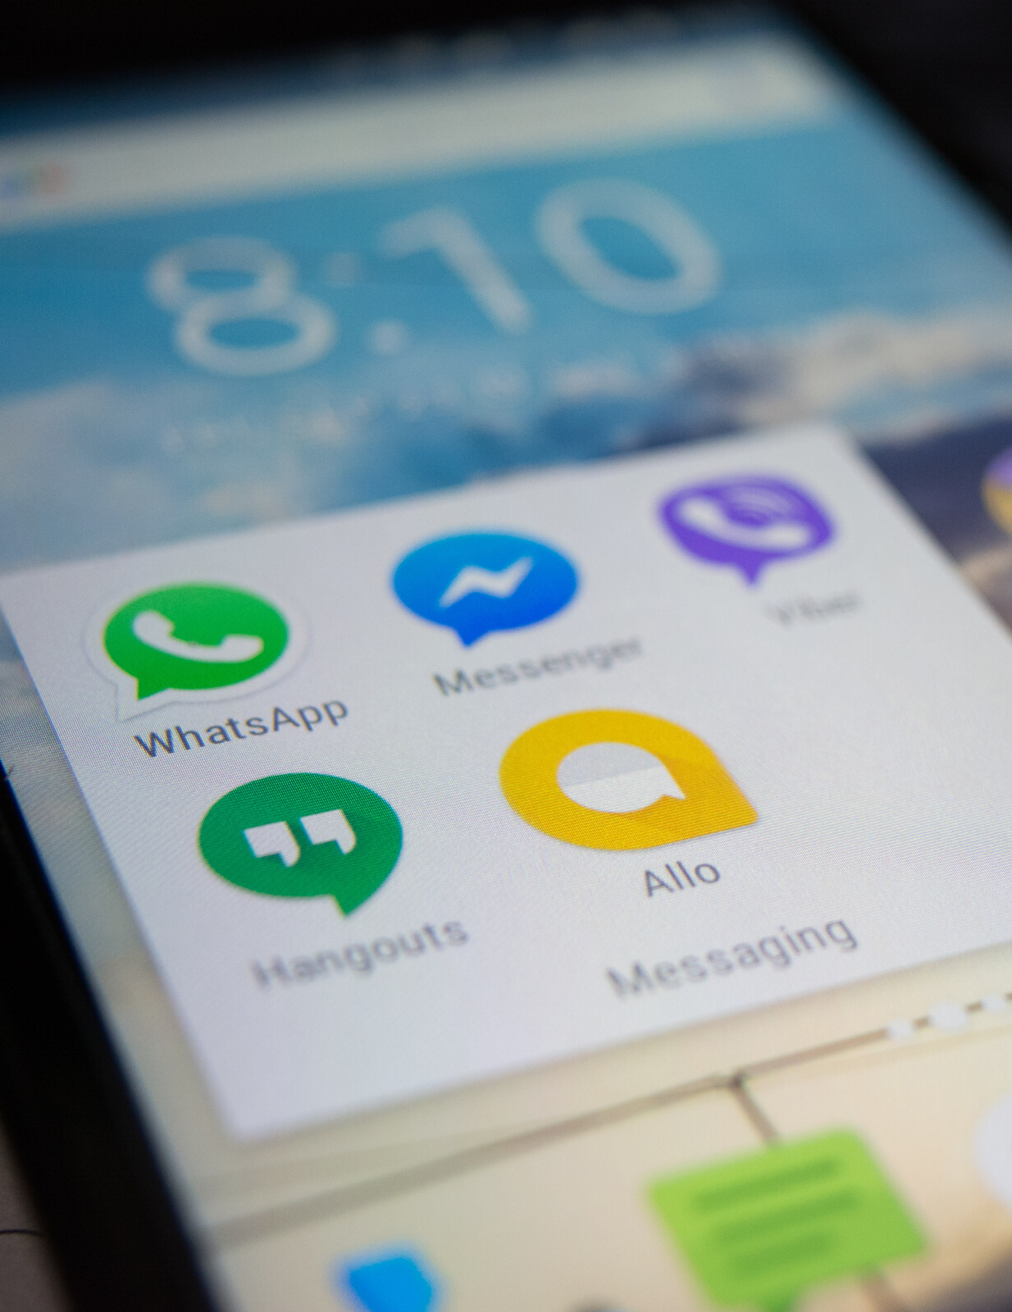


Smishing Attack:
- a form of phishing that attempts to trick you into giving up private info via a text or SMS message.
Notes:
Edit fonts, colours, language and add your logo
Download when finished by going to: File >> Save/Download (either .jpeg or .png format)
Share your ad across social media and link to your relevant landing page

Slide 17
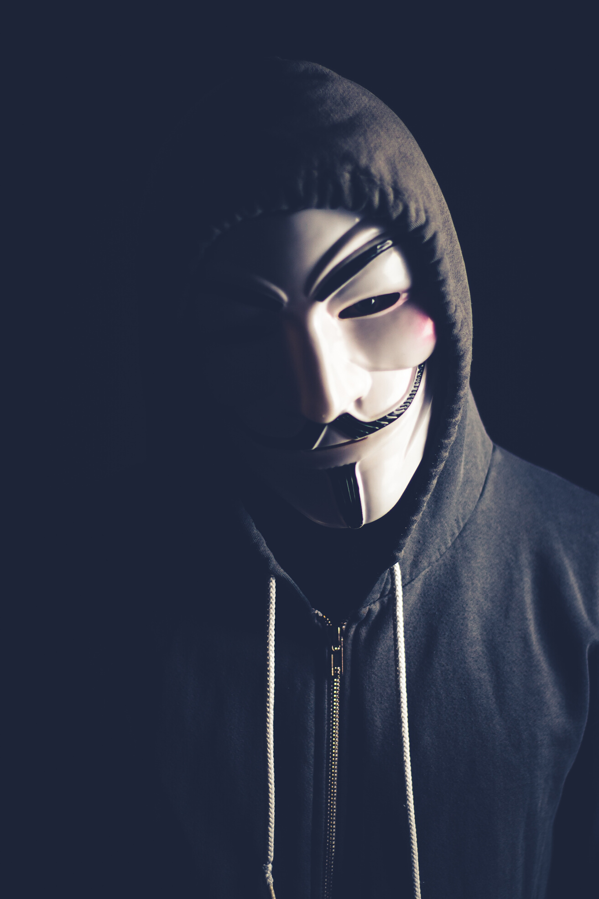

By 2023,
33 Billion
records will be stolen annually by cyber criminals.
Notes:
Edit fonts, colours, language and add your logo
Download when finished by going to: File >> Save/Download (either .jpeg or .png format)
Share your ad across social media and link to your relevant landing page
Source: Juniper Research

Slide 18

Hackers attack every
39 seconds.
On average, 2,244 time a day.
Notes:
Edit fonts, colours, language and add your logo
Download when finished by going to: File >> Save/Download (either .jpeg or .png format)
Share your ad across social media and link to your relevant landing page
Source: Security Magazine

Slide 19

The average time to identify a breach
in 2019 was
206 days.
Notes:
Edit fonts, colours, language and add your logo
Download when finished by going to: File >> Save/Download (either .jpeg or .png format)
Share your ad across social media and link to your relevant landing page
Source: IBM

Slide 20
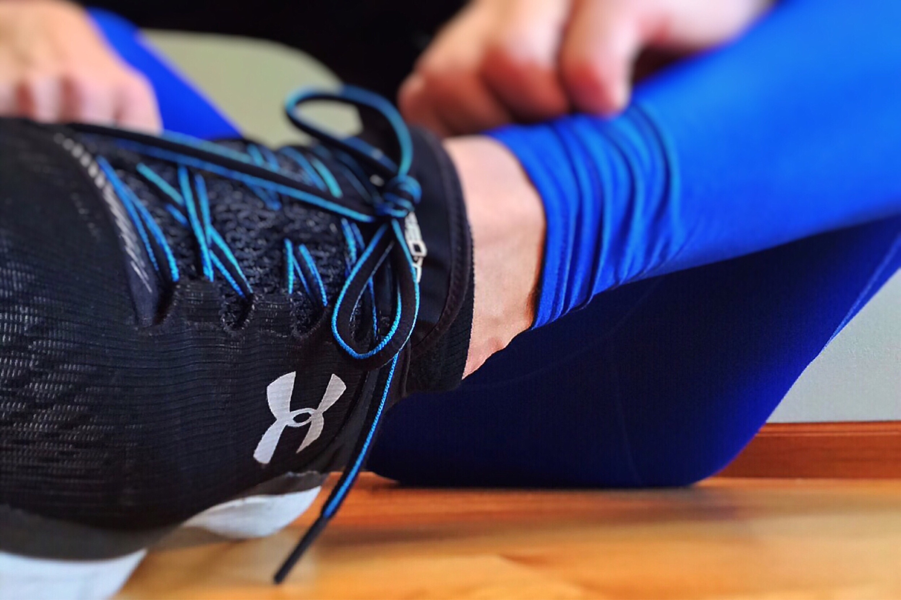
In 2018, "My Fitness Pal" was hacked, affecting
150M
users' sensitive data.
Notes:
Edit fonts, colours, language and add your logo
Download when finished by going to: File >> Save/Download (either .jpeg or .png format)
Share your ad across social media and link to your relevant landing page

Slide 21

Data breaches exposed
4.1 Billion
records in the first half of 2019.
Notes:
Edit fonts, colours, language and add your logo
Download when finished by going to: File >> Save/Download (either .jpeg or .png format)
Share your ad across social media and link to your relevant landing page
Source: Risk Based Security

Slide 22

Phishing accounts for 90% of data breaches
Train your users to spot the warning signs
Notes:
Edit fonts, colours, language and add your logo
Download when finished by going to: File >> Save/Download (either .jpeg or .png format)
Share your ad across social media and link to your relevant landing page
Statistic: Verizon’s Data Breach Digest

Slide 23
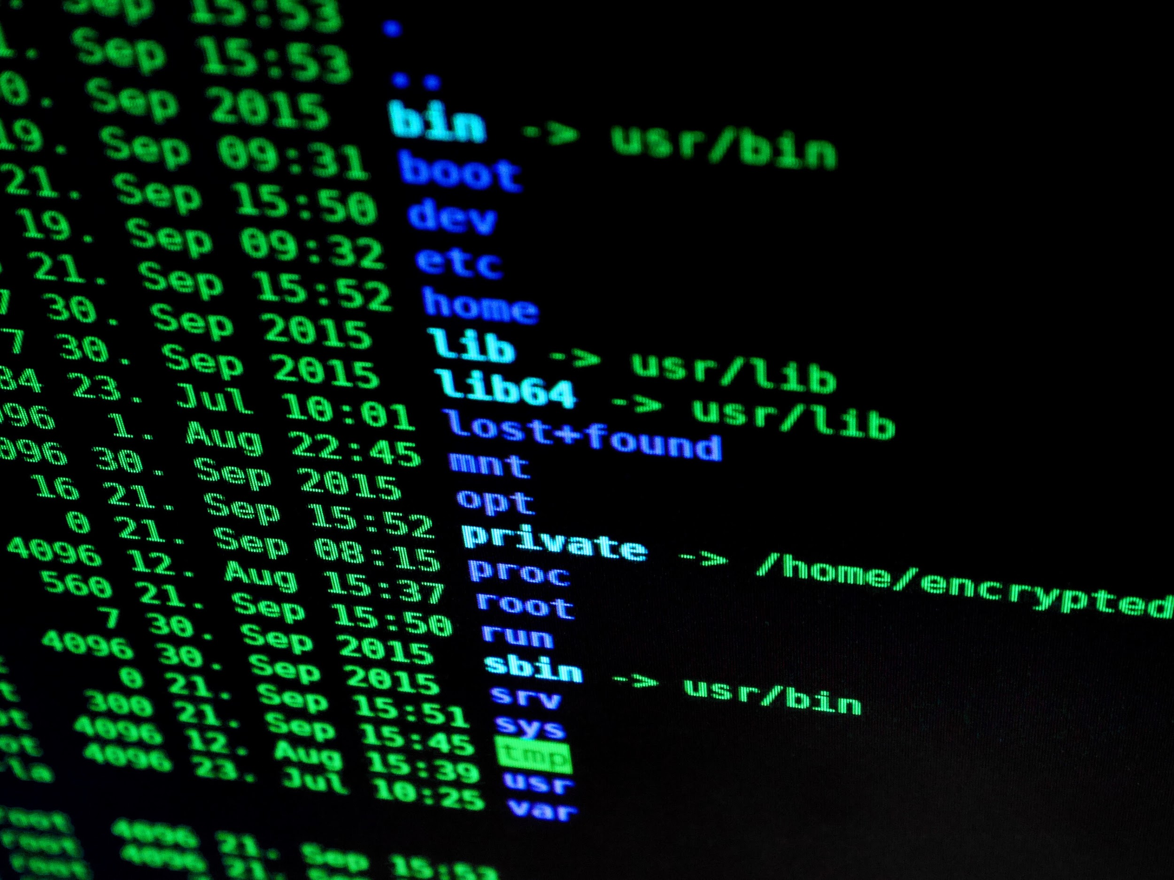

In 2019, a monster data breach containing
1.16 Billion
emails and passwords was discovered... one of the largest ever found.
Notes:
Edit fonts, colours, language and add your logo
Download when finished by going to: File >> Save/Download (either .jpeg or .png format)
Share your ad across social media and link to your relevant landing page
Source: Have I Been Pwned

Slide 24

The average cost of
a data breach is
$3.92M
as of 2019.
Notes:
Edit fonts, colours, language and add your logo
Download when finished by going to: File >> Save/Download (either .jpeg or .png format)
Share your ad across social media and link to your relevant landing page
Statistic: Ponemon - Cost of a Data Breach Report 2019

Slide 25

78%
of employees are aware of the risks of suspicious links in emails, but click the link anyway.
Notes:
Edit fonts, colours, language and add your logo
Download when finished by going to: File >> Save/Download (either .jpeg or .png format)
Share your ad across social media and link to your relevant landing page
Source: FAU

Slide 26
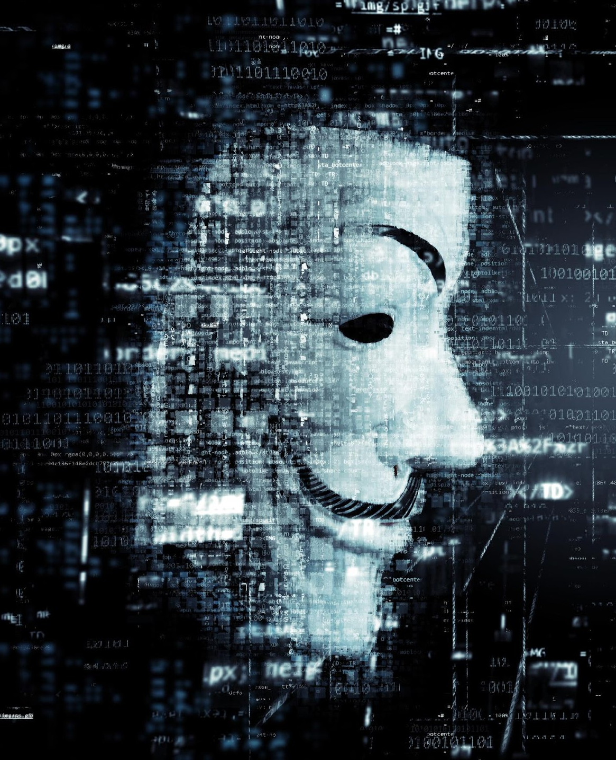
Between 2018 and 2023,
Between 2018 and 2023,
146 Billion
146 Billion
records will be exposed in data breaches.
records will be exposed in data breaches.
Notes:
Edit fonts, colours, language and add your logo
Download when finished by going to: File >> Save/Download (either .jpeg or .png format)
Share your ad across social media and link to your relevant landing page
Source: Juniper Research

Slide 27


Security-related risks
are reduced by
70%
when businesses invest in cyber security awareness training
Notes:
Edit fonts, colours, language and add your logo
Download when finished by going to:
File >> Save/Download (either .jpeg or .png format)
Share your ad across social media and link to your relevant landing page
Data Source: The Aberdeen Group

Slide 28

52%
of business leaders don't know what to do in the event of a cyber security incident.
Notes:
Edit fonts, colours, language and add your logo
Download when finished by going to: File >> Save/Download (either .jpeg or .png format)
Share your ad across social media and link to your relevant landing page
Source: CyberArk Global Advanced Threat Landscape Report 2018: Focus on Devops.

Slide 29


65%
of all known groups carrying out targeted cyber attacks, use spear phishing as the primary infection vector.
Notes:
Edit fonts, colours, language and add your logo
Download when finished by going to: File >> Save/Download (either .jpeg or .png format)
Share your ad across social media and link to your relevant landing page
Source: Symantec

Slide 30

45%
of employees receive no cyber security awareness training from their employer.
Notes:
Edit fonts, colours, language and add your logo
Download when finished by going to: File >> Save/Download (either .jpeg or .png format)
Share your ad across social media and link to your relevant landing page
Source: CompTIA

